Slide 1

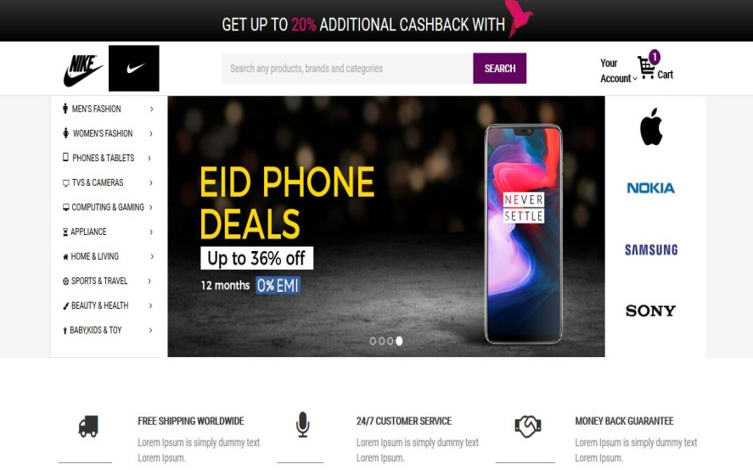
E-COMMERCE WEBSITE
Project Members:
Arafat Bin Kashem
ID:16201066
All Mamun
ID:16101071

Slide 2
What is This?
We will design a e-commerce website where the products will be properly categorized. There will be unique features to make it easier for the customers to navigate the site and find their cherished product easily.

Slide 3
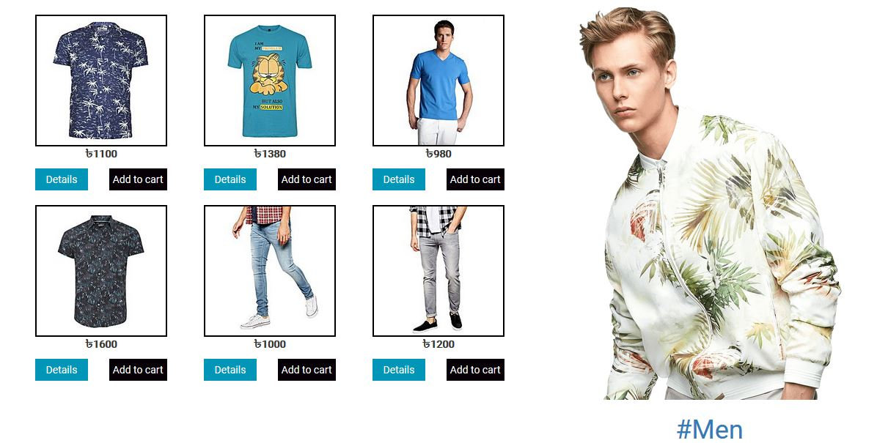
MEN PART

Slide 4
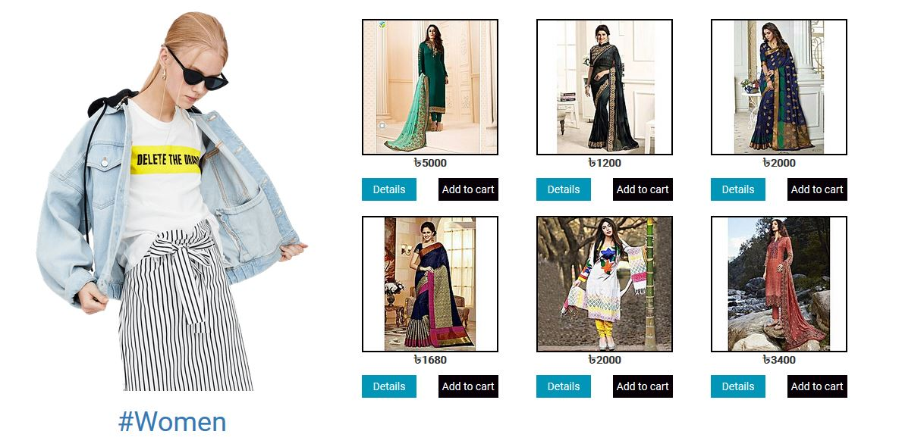
WOMEN PART

Slide 5





C O D E C Y C L E
Front End:
Back End:
Database:

Slide 6
Gantt Chart:
Gantt Chart
Week 2: Project Idea Presentation
Week 3: Analysis Diagram
Week 4: Design Diagram
+ Data Flow Diagram
Week 5: Code Submission + Testing
Week 6: Software Submission
Start
Close
2019
May 2
May
16
June
13
June
27
July
11
July
25

Slide 7
Thank You

